Slide 1

ASYNC IO
Presented by:
Tuğba Karalar Enginel
200202002

Slide 2
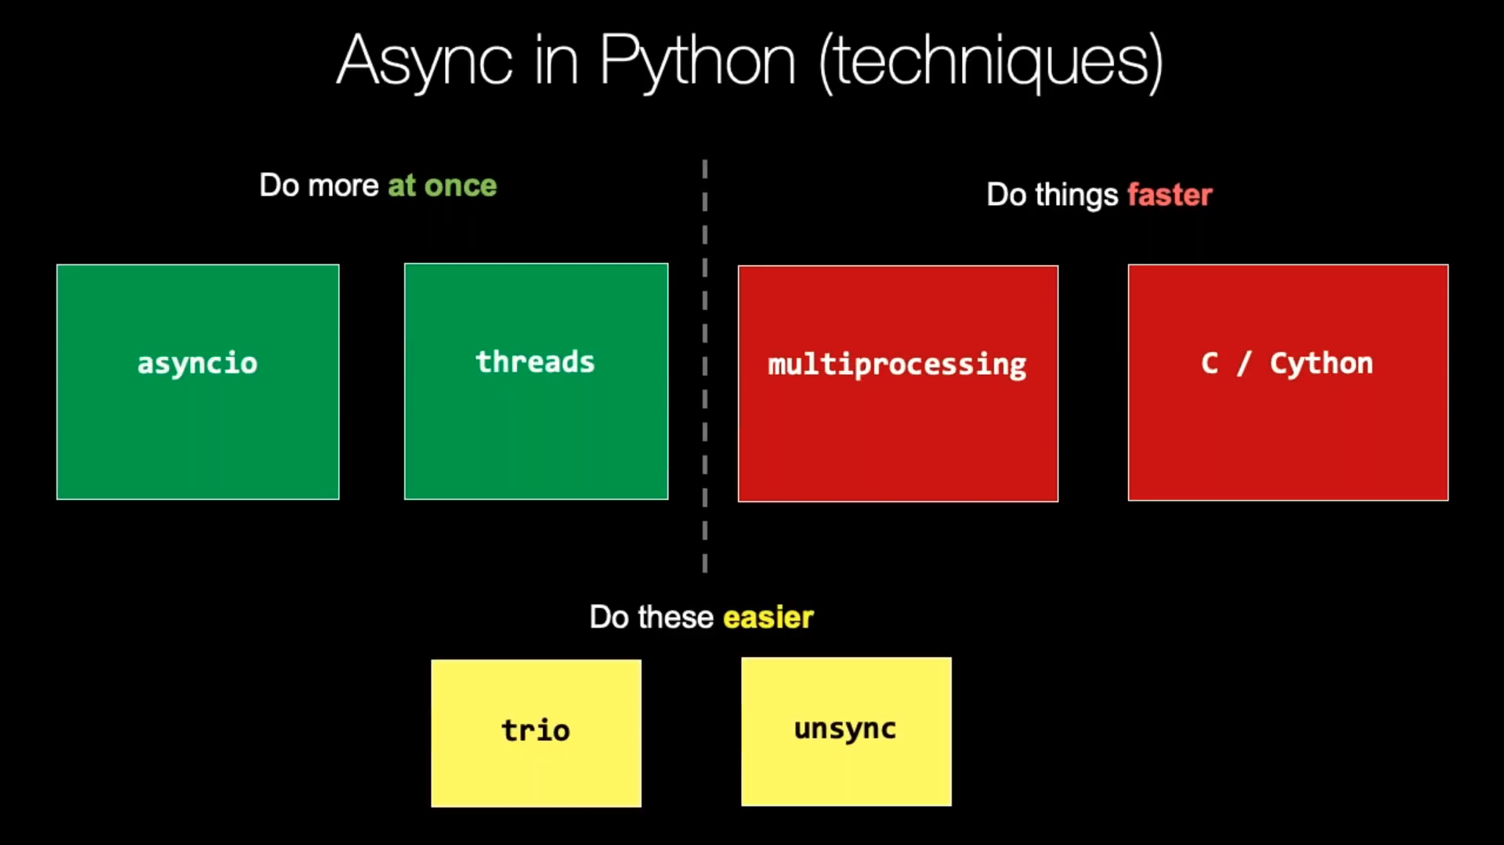

Slide 3
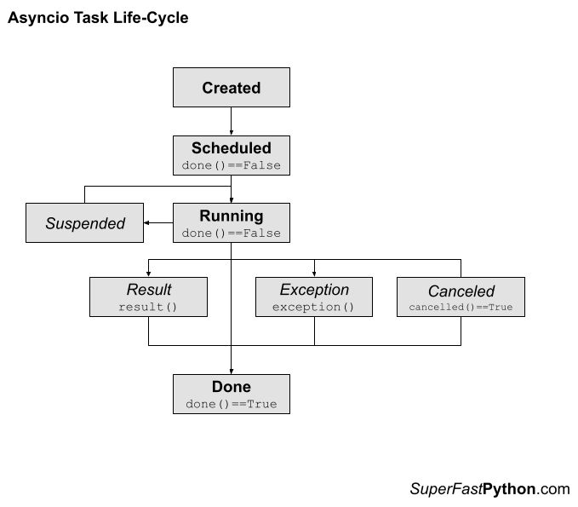

Slide 4

Introduction
Python's asyncio library provides a powerful and easy-to-use way of writing asynchronous code.

Slide 5
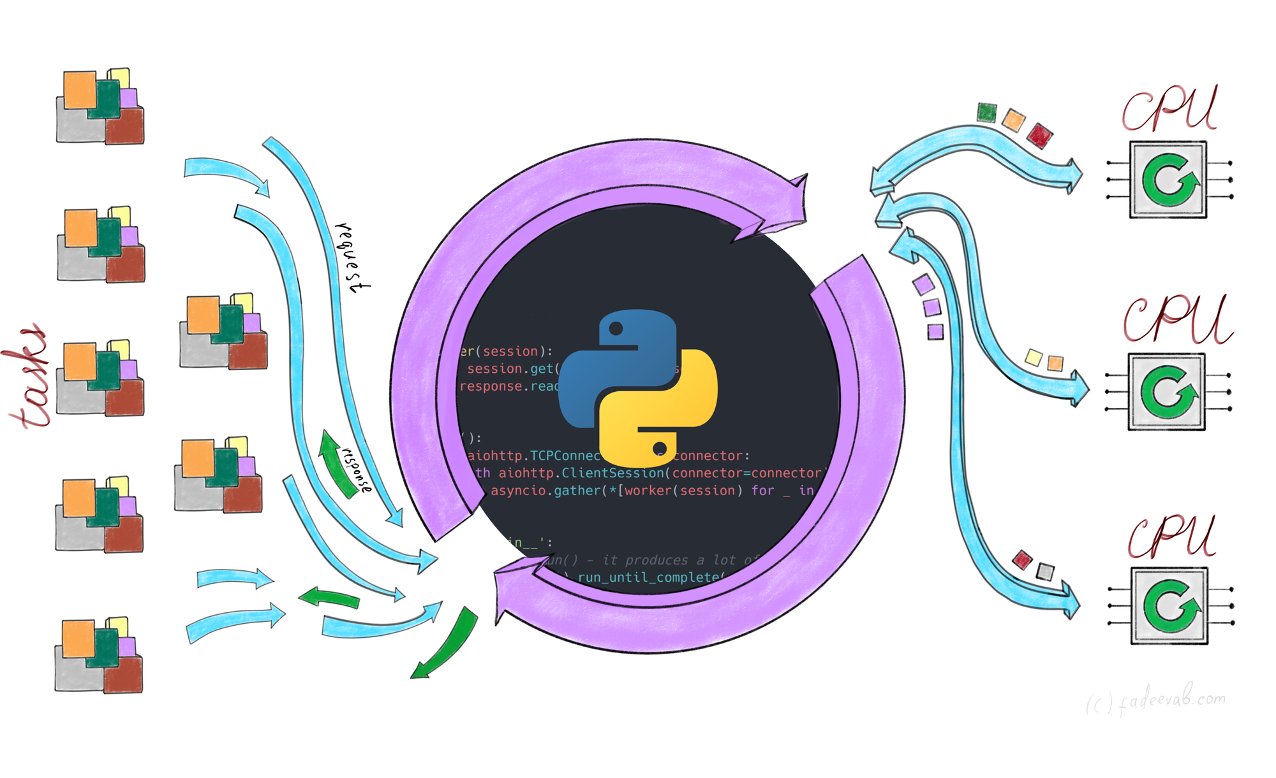
In this presentation, I'll explore the basics of asyncio and how it can be used to write efficient and scalable asynchronous code in Python.

Slide 6
What is asyncio?
asyncio is a Python library that provides tools for writing asynchronous code.
Asynchronous code allows multiple tasks to be executed concurrently, without blocking the program's main thread.
This is achieved through the use of coroutines, which are functions that can be paused and resumed later.
asyncio provides a way of scheduling and running coroutines, allowing them to run concurrently.

Slide 7
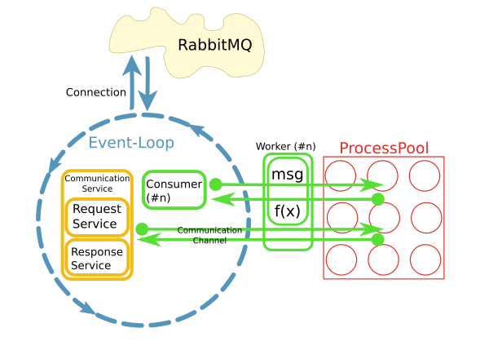
Asyncio provides several key features for building asynchronous applications

Slide 8
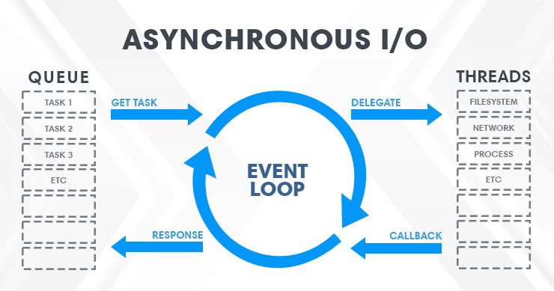
An event loop
This is a core component of Asyncio that manages the scheduling and execution of coroutines.
The event loop monitors I/O events and triggers call backs when data is available or a task is complete.

Slide 9
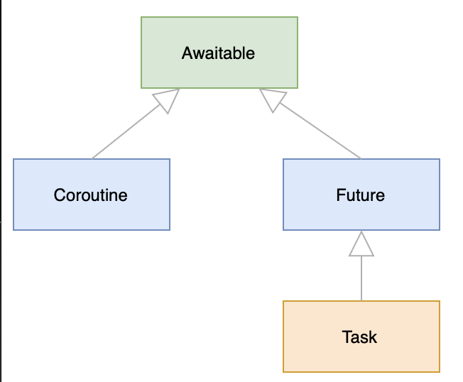
Futures
Futures can be used to wait for a task to complete, or to chain together multiple asynchronous operations.

Slide 10
Tasks
These are coroutines that are scheduled to run on the event loop.
Tasks can be created from coroutines using the asyncio.create_task function, and can be cancelled or awaited to control their execution.

Slide 11

Asyncio provides a powerful set of tools for building asynchronous applications in Python, allowing developers to write code that is efficient, responsive, and scalable.

Slide 12
How to use asyncio?

Slide 13
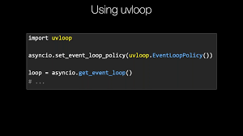
To use asyncio, we first need to create an event loop, which is responsible for scheduling and running coroutines.
We can create an event loop using the asyncio.get_event_loop() function.

Slide 14
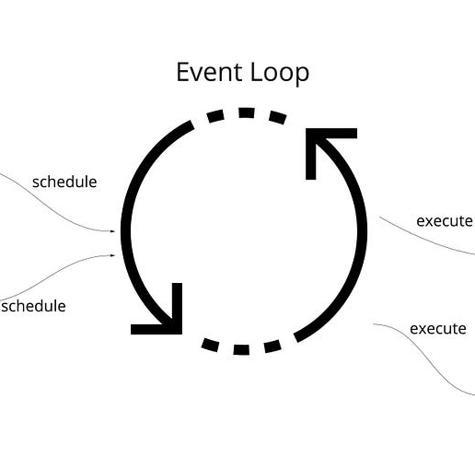
Once we have an event loop, we can run coroutines using the asyncio.run() function.

Slide 15
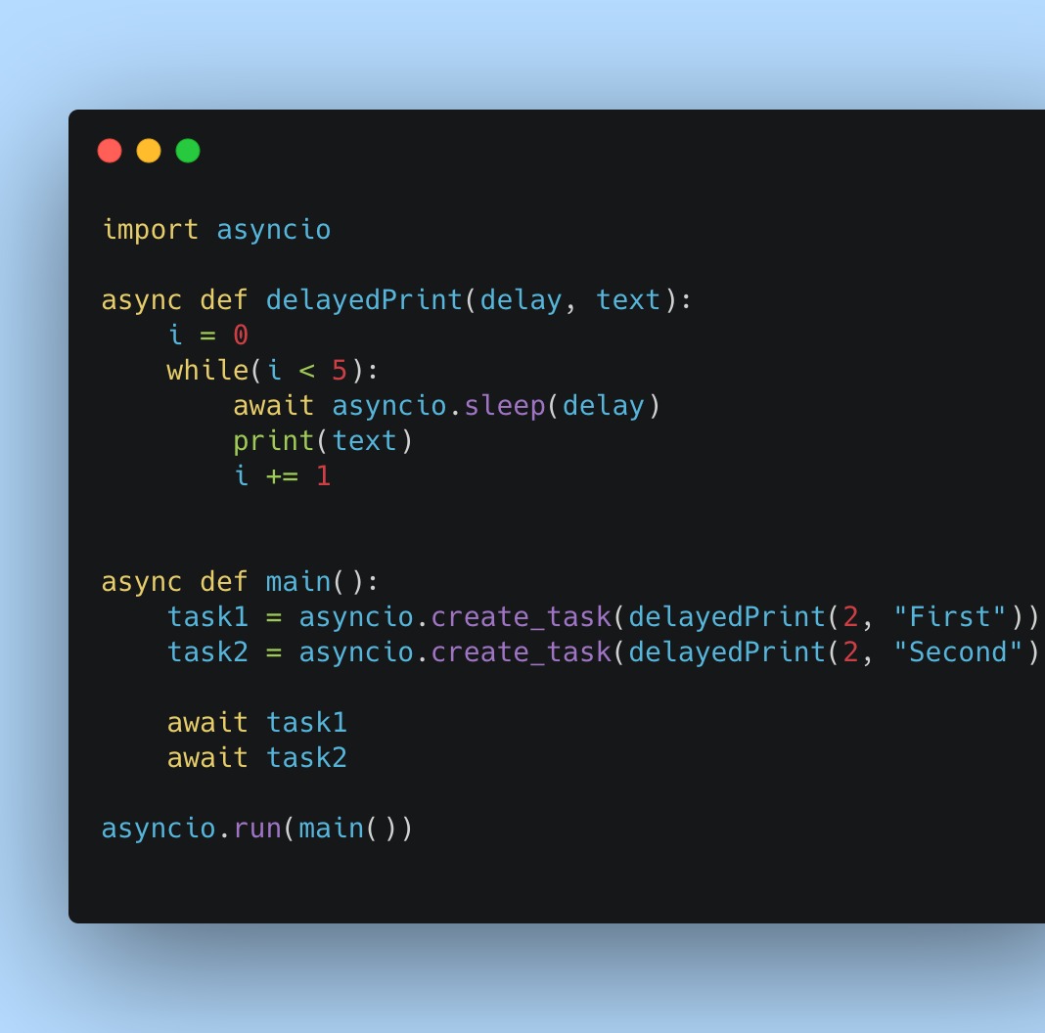
We can define coroutines using the async def syntax, which allows us to use the await keyword to pause and resume execution.
We can also use asyncio's built-in functions and classes to work with coroutines, such as asyncio.sleep() to pause execution for a given amount of time.

Slide 16
Another simple step-by-step guide for using Asyncio

Slide 17

Import the Asyncio library

Slide 18
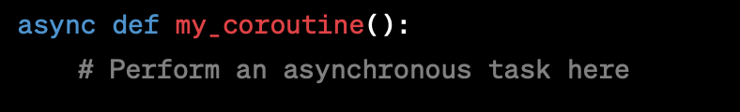
Define one or more coroutines that perform asynchronous tasks. A coroutine is defined using the async def keyword

Slide 19
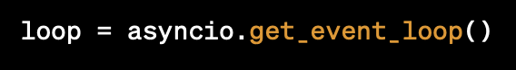
Create an event loop using the asyncio.get_event_loop() function

Slide 20
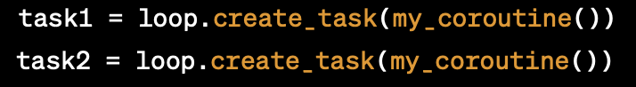
Schedule the coroutines to run on the event loop using the loop.create_task() function

Slide 21
Run the event loop using the loop.run_until_complete() function. This will start executing the scheduled coroutines:

Slide 22

In this example, we used the asyncio.gather() function to run both tasks concurrently, and waited for both tasks to complete before exiting.

Slide 23
This simple example demonstrates how to use Asyncio to schedule and run asynchronous tasks on an event loop.

Slide 24
In more complex applications, you may need to use other features of Asyncio, such as futures, tasks, and locks, to coordinate and manage the execution of multiple coroutines.

Slide 25
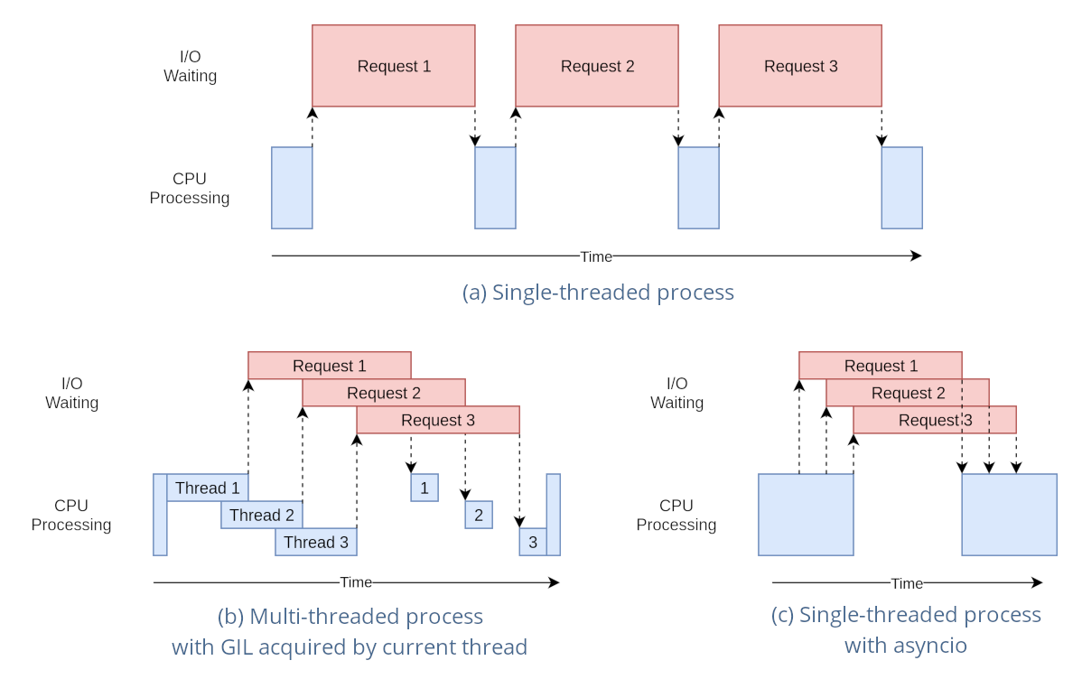
Features and functionalities of asyncio

Slide 26
Asynchronous networking: asyncio can be used to write network servers and clients that handle multiple connections concurrently.

Slide 27
Web scraping: asyncio can be used to scrape websites in parallel, improving performance and reducing the risk of getting blocked by the server.

Slide 28
Concurrency: asyncio can be used to run multiple CPU-bound tasks concurrently, improving overall program performance.

Slide 29
Futures: asyncio provides a way of working with future objects, which represent values that may not be available yet.

Slide 30
Queues: asyncio provides a way of working with queues, which can be used to communicate between coroutines.

Slide 31
Subprocesses: asyncio can be used to run subprocesses concurrently, allowing for more efficient and scalable programs.

Slide 32
Coroutines: Asyncio provides a way to write coroutines in Python, which are functions that can be paused and resumed at any time. This allows for non-blocking I/O and concurrency in a single thread.

Slide 33
Event loop: Asyncio includes an event loop that manages the execution of coroutines. The event loop schedules tasks to run in a cooperative manner, so that when one task is blocked waiting for I/O, another task can run.

Slide 34
Tasks: Asyncio tasks are scheduled coroutines that can be started, paused, and resumed by the event loop.

Slide 35
Synchronization primitives: Asyncio provides several synchronization primitives, such as locks, events, and semaphores, that can be used to coordinate access to shared resources between coroutines.

Slide 36
Protocol implementations: Asyncio provides implementations of various network protocols, such as TCP, UDP, and SSL.

Slide 37
Context variables: Asyncio allows the creation of context variables, which are variables that can be accessed by all coroutines running in the same context. This can be useful for storing thread-local data in an asynchronous environment.

Slide 38
Debugging tools: Asyncio includes debugging tools that can be used to identify and fix problems in asynchronous code.

Slide 39
Best practices for asyncio
Use asyncio's built-in functions and classes whenever possible, as they are designed to work well with the event loop.
Be careful when mixing synchronous and asynchronous code, as this can lead to blocking the event loop and reducing performance.
Use asyncio's async with statement to manage resources that need to be acquired and released asynchronously.
Use asyncio's gather() function to run multiple coroutines concurrently.

Slide 40
Here are some best practices to follow when using asyncio

Slide 41
Use asyncio only when it makes sense:
Asyncio is great for I/O-bound tasks, but it's not always the best choice for CPU-bound tasks.
If your code is spending most of its time doing CPU-intensive computations, asyncio might not provide much benefit.

Slide 42
Use asyncio with compatible libraries:
Asyncio is most effective when used with other async libraries that are built with asyncio in mind.
If you're using an async library that doesn't work with asyncio, you might need to use threads or processes instead.

Slide 43
Keep your coroutines short and non-blocking:
When writing coroutines, try to keep them as short as possible and avoid blocking operations whenever possible.
This helps to ensure that the event loop can switch between coroutines efficiently.

Slide 44
Use async/await syntax:
The async/await syntax introduced in Python 3.5 makes it much easier to write asyncio code.
Using this syntax can help make your code more readable and easier to maintain.

Slide 45
Use asyncio.sleep() instead of time.sleep():
If you need to introduce a delay in your code, use asyncio.sleep() instead of time.sleep().
This allows other coroutines to run while your coroutine is waiting.

Slide 46
Avoid creating unnecessary tasks:
Creating too many tasks can slow down the event loop and lead to decreased performance.
Make sure to only create tasks when necessary and keep the number of active tasks under control.

Slide 47
Use asyncio.gather() to run multiple coroutines concurrently:
The asyncio.gather() function allows you to run multiple coroutines concurrently and wait for all of them to complete.

Slide 48
Handle errors gracefully:
When using asyncio, it's important to handle errors gracefully.
Make sure to catch and handle exceptions appropriately, and use the try/except/finally syntax to ensure that resources are cleaned up properly.

Slide 49
By following these best practices, you can write efficient and maintainable asyncio code that takes advantage of the benefits of asynchronous programming.

Slide 50
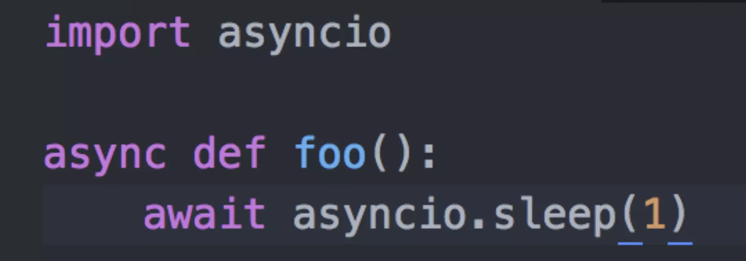
Asyncio is used as a foundation for multiple Python asynchronous frameworks that provide
Multiplexing I/O access over socket and other resources ,
high-performance network,
database connection libraries,
distributed task queues,
web-servers,
running network clients and servers,
etc.

Slide 51

What is the benefit of asyncio in Python?
Efficient and easy-to-use way of writing asynchronous code.
Multiple tasks to be executed concurrently, without blocking the program's main thread.
This can result in significant performance improvements, especially in the context of network programming and web applications.

Slide 52
With asyncio, developers can write code that is both concurrent and efficient, without the complexity and overhead of traditional multi-threading or multi-processing approaches.
Asyncio provides a set of tools for working with coroutines, which are lightweight and efficient units of execution that can be paused and resumed.
This allows for more fine-grained control over program execution, resulting in better performance and responsiveness.

Slide 53

Furthermore, asyncio provides a rich set of features and functionalities, such as:
asynchronous networking,
web scraping,
concurrency,
futures,
queues,
subprocesses.
These tools allow developers to build complex and scalable applications that are optimized for performance and efficiency.

Slide 54
In summary, the benefits of asyncio in Python include:
Efficient and easy-to-use asynchronous programming
Significant performance improvements, especially in network programming and web applications
Lightweight and efficient coroutines for more fine-grained control over program execution
Rich set of features and functionalities for building complex and scalable applications.

Slide 55
When to Use Asyncio

Slide 56
There are seven possible reasons to use asyncio in a Python project.
They are:
1- Coroutines in your program.
a) Use coroutines as an alternative to threads and processes.
b) Achieve scalability offered by coroutines compared to threads.
2- The asynchronous programming paradigm.
3- Non-blocking I/O.
4- Network I/O
5- CPU-bound tasks
6- Parallelism
7- Event-driven applications

Slide 57
Reason 1: To Use Coroutines
Coroutines are a type of subroutine that can be suspended and resumed, allowing them to cooperate by design and choose how and when to suspend their execution.
Compared to threads, coroutines are more lightweight, faster to start, and use less memory, making it possible to have a large number of seemingly simultaneous functions in a program.

Slide 58
While coroutines are well-suited to non-blocking I/O tasks with subprocesses and sockets, they can also be used for blocking I/O and CPU-bound tasks in a simulated non-blocking manner.
Ultimately, the choice to use coroutines in a program can lead to an interesting and powerful approach to concurrency that is different from traditional thread-based and process-based concurrency.

Slide 59
Reason 2: To Use Asynchronous Programming
Asynchronous programming refers to making requests and not blocking to wait for them to complete.
It allows for tasks to be performed later in the background while the program can perform other tasks.

Slide 60
Asynchronous programming in Python can be implemented in various ways, but full asynchronous programming requires the use of coroutines and the asyncio module.
This module allows for executing blocking I/O and CPU-bound tasks in an asynchronous manner, even simulating non-blocking behavior via threads and processes.
Choosing to use asyncio for asynchronous programming in a Python program is a defensible reason, independent of using non-blocking I/O.

Slide 61
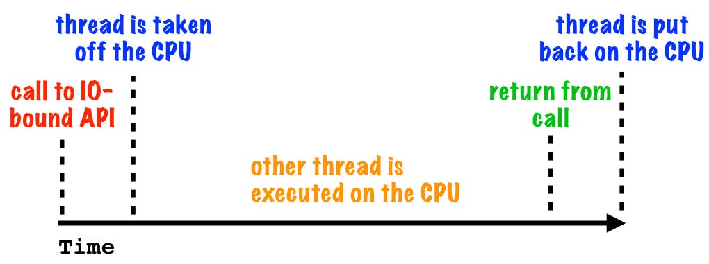
Reason 3: To Use Non-Blocking I / O
The difference between blocking I/O and non-blocking I/O, where I/O refers to input/output operations such as:
reading and writing from various resources,
including hard disk drives,
peripherals,
the internet,
databases,
email.
IO-bound blocking

Slide 62
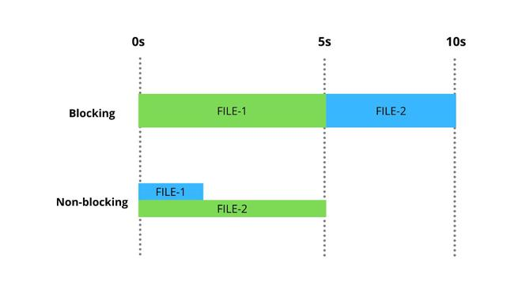
Blocking I/O tasks make a read or write request and then wait for the data to be sent or received, whereas non-blocking I/O allows read and write calls to be made as asynchronous requests,
which means that the operating system will handle the request and notify the calling program when the results are available.

Slide 63
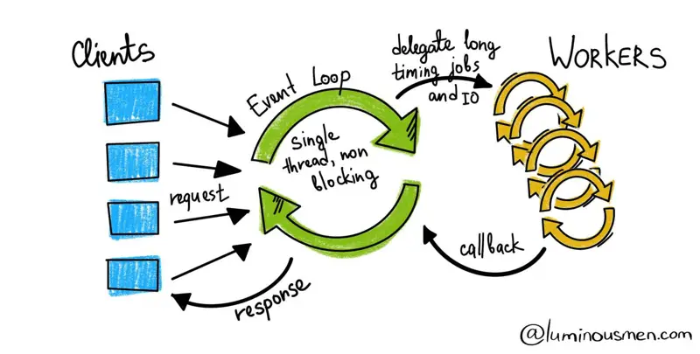
The asyncio module in Python was added specifically to add support for non-blocking I/O with subprocesses and streams.
It provides first-class asynchronous programming for non-blocking I/O via coroutines, event loops, and objects.
Using asyncio may be necessary or desired in programs that require or want non-blocking I/O.

Slide 64
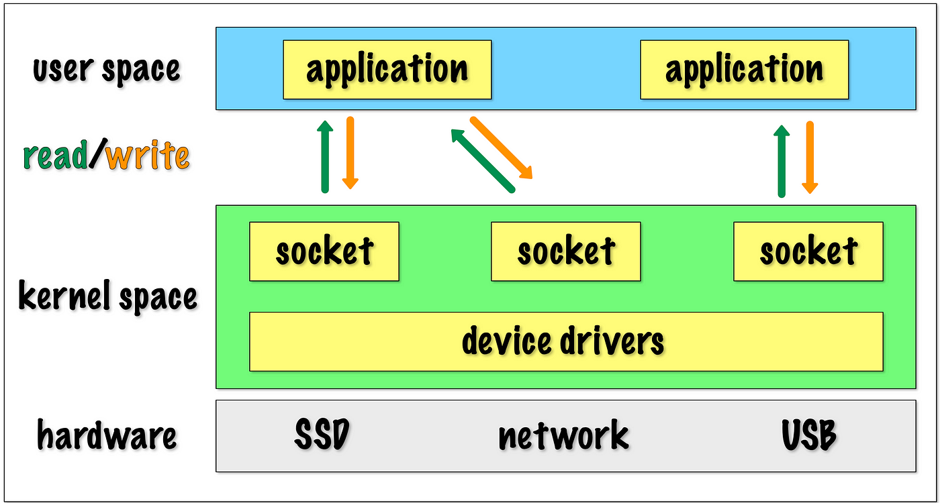
Reason 4: Network I/O
If your application needs to interact with network resources, such as:
HTTP APIs,
Web-sockets,
Databases.
Asyncio can help you manage the I/O operations in a non-blocking way, allowing your application to handle multiple requests simultaneously.

Slide 65
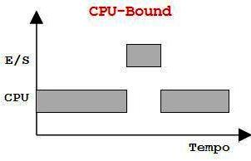
Reason 5: CPU-bound tasks
Although Asyncio is primarily designed for I/O-bound tasks, it can also be useful for running CPU-bound tasks that don't require the global interpreter lock (GIL) to be held,
such as:
mathematical computations
or
image processing.

Slide 66
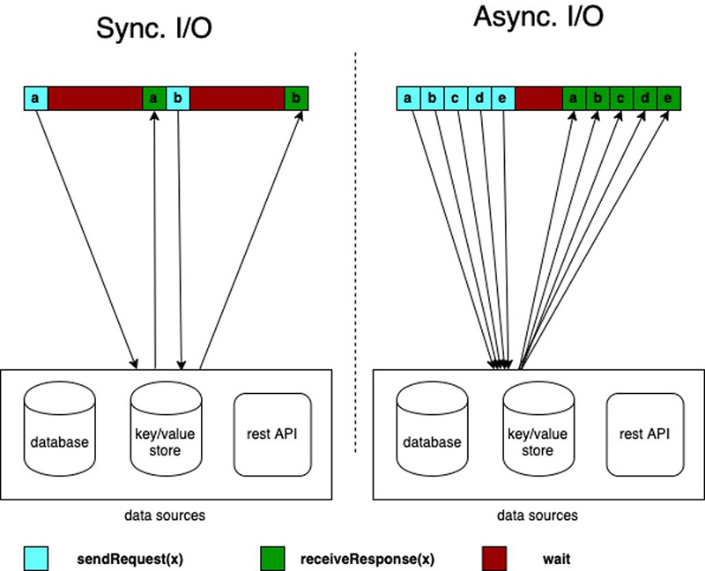
Reason 6: Parallelism
If your application needs to perform multiple tasks simultaneously,
Asyncio can help you manage the execution of these tasks in a non-blocking way, allowing them to run concurrently.

Slide 67
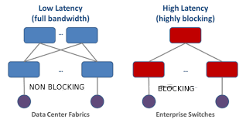
Reason 7: Event-driven applications
If your application needs to respond to external events, such as user input or system signals,
Asyncio can help you manage these events in a non-blocking way, allowing your application to respond to them quickly and efficiently.

Slide 68
Here are a few examples of how Asyncio can be used in Python:

Slide 69
Web scraping
When scraping websites for data, Asyncio can be used to fetch the HTML content of multiple pages simultaneously, improving the speed and efficiency of the process.

Slide 70
Server programming:
When building servers, Asyncio can be used to handle multiple connections and requests simultaneously, without blocking the main thread.

Slide 71
Database programming
When interacting with databases, Asyncio can be used to execute queries asynchronously, allowing your application to continue processing other requests while waiting for the database to respond.

Slide 72
GUI programming
When building graphical user interfaces, Asyncio can be used to manage user interactions and events in a non-blocking way, improving the responsiveness and performance of the application.

Slide 73
IoT applications
When working with Internet of Things (IoT) devices, Asyncio can be used to manage multiple connections and events simultaneously, allowing your application to respond to data streams from multiple sensors or devices in real-time.

Slide 74
Overall, Asyncio can be used in a wide variety of applications where
non-blocking I/O,
concurrency, and
event-driven programming
are important.

Slide 75
Here are some specific code examples to illustrate how Asyncio can be used:

Slide 76
Asynchronous HTTP request

Slide 77
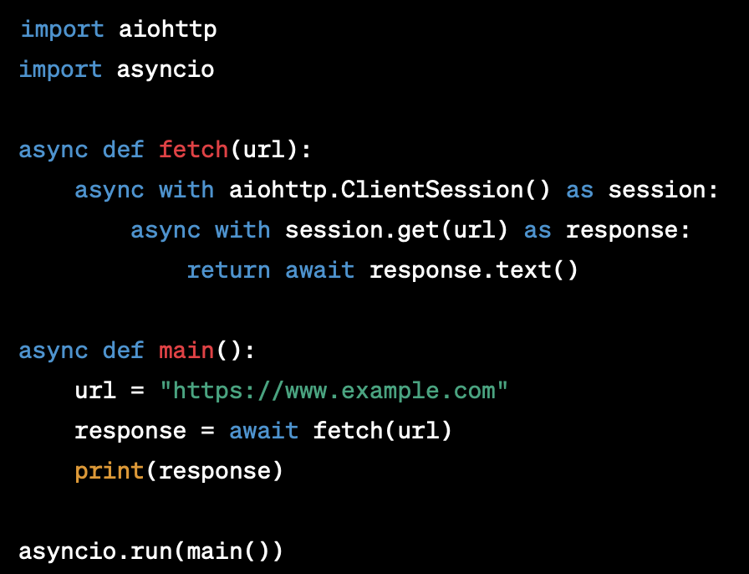
In this example, we use Asyncio to make an HTTP request to a URL asynchronously.
The fetch function uses the aiohttp library to make an HTTP GET request to the specified URL, and returns the response content as text.
The main function uses the asyncio.run function to execute the coroutine and print the response content.

Slide 78
Asynchronous file I/O:

Slide 79
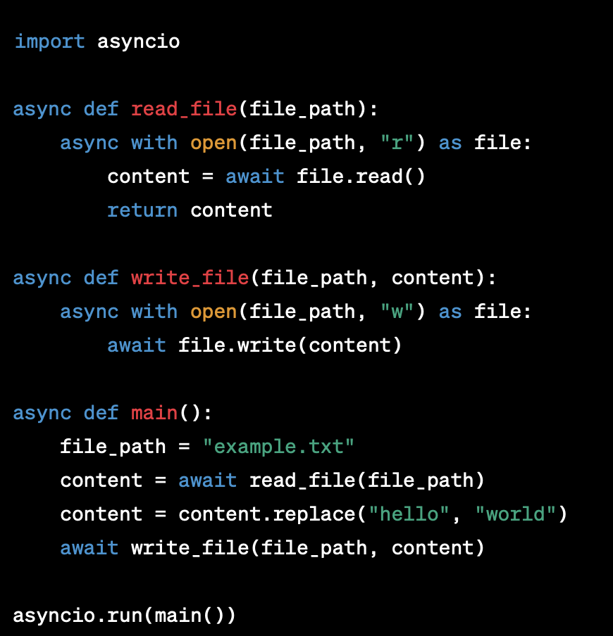
In this example, we use Asyncio to perform file I/O operations asynchronously.
The read_file function opens a file for reading, reads the contents of the file asynchronously, and returns the content as a string.
The write_file function opens a file for writing, writes the content to the file asynchronously, and then closes the file.
The main function reads the content of a file, replaces a substring, and writes the modified content back to the same file.

Slide 80
Asynchronous parallelism:

Slide 81
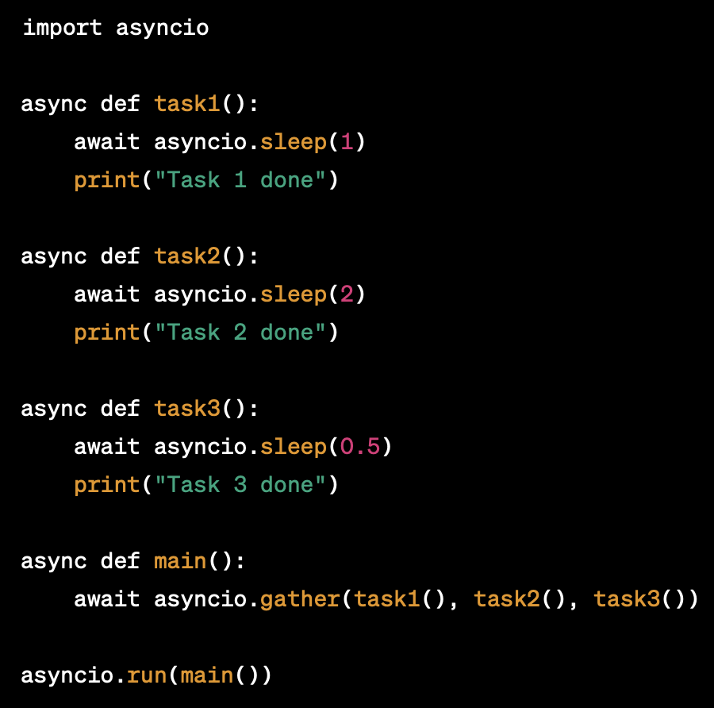
In this example, we use Asyncio to execute multiple tasks concurrently in parallel.
The task1, task2, and task3 functions each simulate a time-consuming task by sleeping for a different amount of time.
The main function uses the asyncio.gather function to execute all three tasks concurrently, and then waits for all of them to finish before exiting.
This demonstrates how Asyncio can be used to improve the performance and responsiveness of an application by running multiple tasks in parallel.

Slide 82
Threaded Model and Web Sockets
In traditional threaded model of web programming, each client connection is handled by a separate thread.
This means that for every client connection, a new thread is created, which can be resource-intensive and limit the number of concurrent connections that a server can handle.

Slide 83

Web sockets, provide a bi-directional communication channel between a client and a server, allowing for real-time data exchange without the need for continuous HTTP requests.
This makes web sockets ideal for applications such as chat rooms, real-time gaming, and financial trading platforms.

Slide 84

When it comes to handling web sockets in a threaded model, there are a few challenges that need to be addressed.
One approach is to use a thread pool to handle incoming web socket connections, with each connection being assigned to a separate thread from the pool.
This can help to reduce the overhead of creating and destroying threads for each connection.

Slide 85

However, this approach can still be resource-intensive, especially if there are a large number of concurrent web socket connections.
As a result, many modern web frameworks and servers use asynchronous programming models, such as asyncio, to handle web socket connections more efficiently.

Slide 86

In an asynchronous model, incoming web socket connections can be handled by a single event loop, which schedules and executes coroutines as needed.
This allows for more efficient use of system resources, as the event loop can handle many connections concurrently without the overhead of creating and destroying threads.

Slide 87

In summary
While the threaded model of web programming can be used to handle web sockets,

Slide 88
it may not be the most efficient approach, especially for large-scale applications with a high number of concurrent connections.
Asynchronous programming models, such as asyncio, can provide a more efficient and scalable solution for handling web sockets.

Slide 89

Conclusion

Slide 90
The asyncio library in Python provides a powerful and easy-to-use way of writing asynchronous code.
By using coroutines and the event loop, we can run multiple tasks concurrently, without blocking the program's main thread.
With the right tools and best practices, writing asynchronous code can be easy and efficient.
The various features and functionalities of asyncio make it a versatile tool for various applications in modern software development.

Slide 91
QUESTIONS

Slide 92
THANK YOU

